Slide 1

Team 1: Bad dog woodshop Final project presentation, 5/11/2022
Zaira perez
Carlie smith
Justin vanhaven

Slide 2
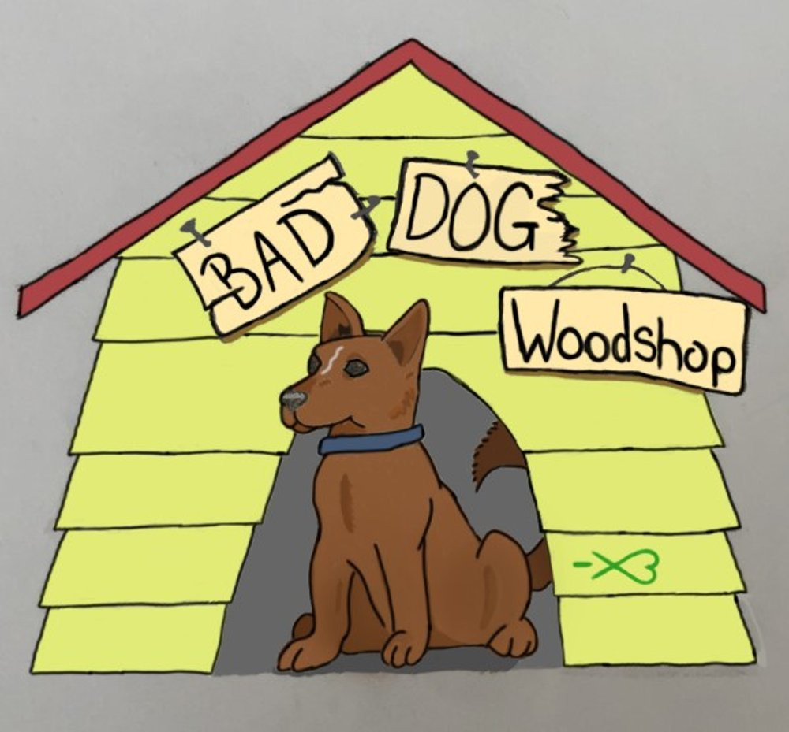
What is bad dog woodshop?
Your house is your home and we can help make it a reflection of your style, comfort and individuality. Custom design and crafting of in-home furniture, cabinetry and home elements is affordable and available to you!
Bring your idea or build one with design consultation. Unique species and sizes are our specialty!
Visit www.BadDogWoodshop.com today!

Slide 3
Concept:
Inventory site for wood products
Motivation – site for actual business
Ability to order – use Stripe for purchases
Modal for custom orders/contact
As a woodshop owner, I would like a website that prospective customers can visit to get an idea of what is possible so that I can accept orders for inventoried products or contact them for custom orders.

Slide 4
Process
Technologies used:
GraphQL, Mongoose, MongoDB, React
Breakdown of tasks and roles: ALL IN!
We collaborated on design and code. Most of our sessions were in single-coder format.
Challenges:
Design, getting seeded inventory to display on Home page
Successes:
Moved forward at all times. Used faker and actual seeds together.

Slide 5
Demonstration

Slide 6
Future development & links
We would want to refine the design
Reset Stripe – we had it set and then made changes so it doesn’t quite work
Include multiple payment options: ApplePay, GooglePay, PayPal, Venmo
~~~~~~~~~~~~~~~~~~~~~~~~~~~~~~~~~~~~~~~~~~~~~~~~~~~~~~~~~~~~~~~~~~~~~
Links:
Github: https://github.com/doctordutch/project3.git
Heroku:

